Slide 1

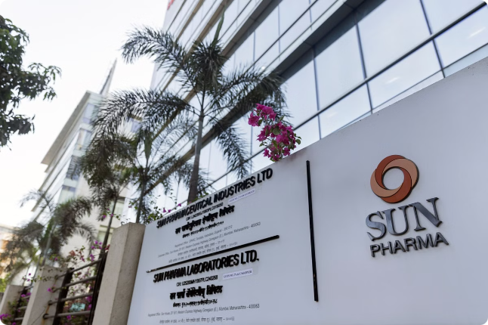
Introduction to Sun Pharma Company
Sun Pharma is a leading global pharmaceutical company that develops, manufactures, and markets a wide range of high-quality generic and branded formulations. Founded in 1983, the company has grown to become one of the largest and most respected pharmaceutical players worldwide.
VM
by Vikshita Mali

Slide 2
Overview of Sun Pharma's Financial Landscape
Diversified Portfolio
Global Footprint
Robust R&D Capabilities
Sun Pharma's product portfolio spans multiple therapeutic areas, including cardiology, neurology, ophthalmology, and oncology, providing a well-balanced revenue stream.
The company has a strong international presence, with operations in over 100 countries and a diverse customer base that includes both developed and emerging markets.
Sun Pharma invests significantly in research and development to drive innovation, maintaining a pipeline of promising new drug candidates.

Slide 3

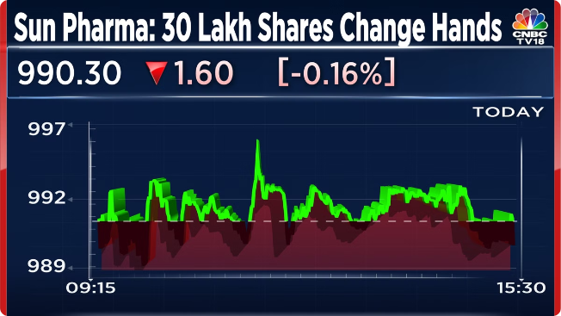
Key Financial Metrics and Performance Indicators
1
Revenue Growth
2
Profit Margins
Sun Pharma has consistently delivered strong revenue growth, driven by its diverse product portfolio and global expansion.
The company's operating and net profit margins have remained healthy, reflecting its focus on operational efficiency and cost optimization.
3
Return on Capital
4
Debt Levels
Sun Pharma's return on invested capital (ROIC) and return on equity (ROE) demonstrate the company's ability to generate sound returns for its shareholders.
The company's debt-to-equity ratio and interest coverage ratio indicate a prudent approach to capital structure and financial risk management.

Slide 4

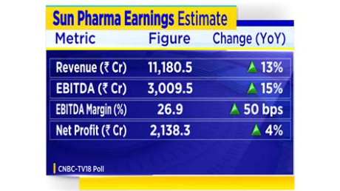
Revenue and Profitability Analysis
Product Mix
1
Sun Pharma's revenue is diversified across its generic and branded drug portfolios, with a focus on high-growth therapeutic areas.
2
Geographic Expansion
The company's strategic investments in emerging markets have contributed to its revenue growth and enhanced its global market share.
Cost Optimization
3
Sun Pharma's efficient manufacturing operations and supply chain management have enabled it to maintain healthy profit margins.

Slide 5


Cost Structure and Operational Efficiency
Vertically Integrated Manufacturing
Supply Chain Optimization
The company's robust supply chain management and inventory control practices contribute to its operational efficiency.
Sun Pharma operates a network of state-of-the-art manufacturing facilities that ensure quality control and cost efficiencies.
Process Automation
Lean Manufacturing
Sun Pharma leverages technology and process automation to streamline its operations and enhance productivity.
The company's commitment to lean manufacturing principles helps to minimize waste and improve overall operational performance.

Slide 6
Working Capital Management
Inventory Control
Accounts Receivable
Accounts Payable
Sun Pharma's effective inventory management practices ensure optimal inventory levels, minimizing carrying costs and enhancing cash flow.
The company's strong credit control and collection processes help to maintain a healthy accounts receivable position.
Sun Pharma leverages its supplier relationships to negotiate favorable payment terms, optimizing its working capital requirements.

Slide 7





Capital Expenditure and Investment Decisions
Capacity Expansion
R&D Investment
Mergers and Acquisitions
Sun Pharma invests in expanding its manufacturing capabilities to support its growth and market share targets.
The company allocates significant resources to research and development to drive innovation and pipeline development.
Sun Pharma strategically pursues acquisitions to enhance its product portfolio, technological capabilities, and geographic reach.

Slide 8

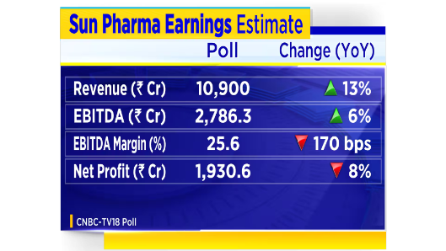



Debt Financing and Capital Structure
Bank Loans
Debt Securities
Equity Financing
Sun Pharma utilizes bank financing to fund its capital requirements and working capital needs.
The company also raises funds through the issuance of corporate bonds and other debt instruments.
Sun Pharma maintains a balanced capital structure, with a mix of debt and equity financing.

Slide 9

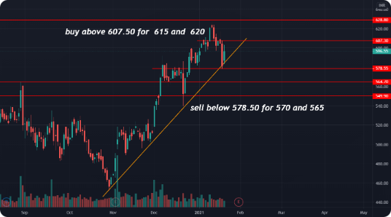
Financial Forecasting and Scenario Analysis
Revenue Profitability Cash Flow Debt Levels Projected growth rates Estimated profit margins Forecasted operating and free cash flow Projected debt-to-equity ratio

Slide 10


Conclusion and Recommendations
1
Robust Financial Performance
2
Diversification and Expansion
Sun Pharma has demonstrated consistent financial strength, with a track record of revenue growth, profitability, and prudent capital management.
The company's diversified product portfolio and global footprint position it well for continued growth and market leadership.
3
Recommendations
Maintain focus on innovation, operational excellence, and strategic investments to further strengthen Sun Pharma's competitive position.

